Slide 1

Rail Budget
Today’s Topics
Survey: Ch. 1, 2, 3
General Budget
(MINUS Schemes)
All PPT Slides @Mrunal.org
General Budget

Slide 2
How prepares Economic Survey?
Draft: Dept. of Economic Affairs
CSO inputs (Min. of Stat & Prog implementation)
Chief Economic Advisor to FM
Finance Secretary + FM

Slide 3
(A): In Recent years, women participation rate in labour force has declined.
(R): There has been a rapid increase in female participation in education – both in rural and urban areas
Answer Choices
both are true and R is the correct explanation of A
both are true but R is not the correct explanation of A
A is true but R is false
A is false but R is true
1. Skip 2. Attempt 3. Mark n Review

Slide 4
Survey ch1, Page5
Assertion (A): In Recent years, women participation rate in labor force has declined.
Reason (R): There has been a rapid increase in female participation in education – both in rural and urban areas
Answer Choices
both are true and R is the correct explanation of A
both are true but R is not the correct explanation of A
A is true but R is false
A is false but R is true
1. Skip 2. Attempt 3. Mark n Review
Notes:
descriptive

Slide 5
1. Introduction
14. Statistical Appendix
Notes:
255, 378

Slide 6

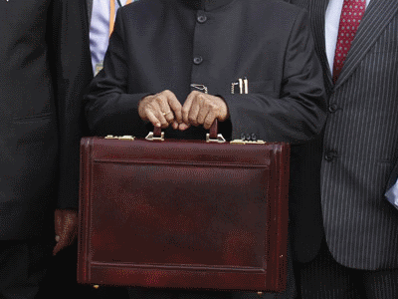
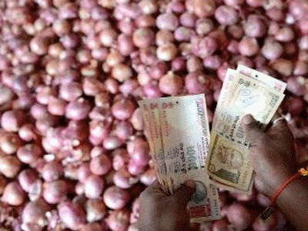
2
3
4
Reform overview
Financial repression
Productivity commission
Budget 2013
AFS Tables
Agro reform
Urjit Patel

Slide 7



5
6
7
FSLRC- IFC
Financial inclusion (Nachiket)
Insurance, NBFC
BOP Table
Fed tapering
EXIM order
Trade agreements

Slide 8
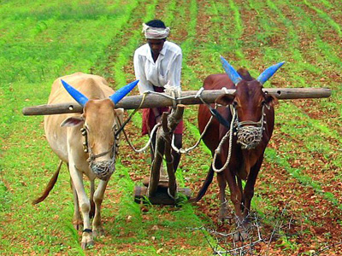
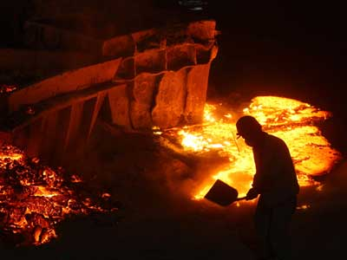

8
9
10
Subsidies
National market
PDS reform
Mining
MSME
Textile
Industrial corridor
Transport
Tourism
IT
Real estate

Slide 9



11
12
13
Energy: CBD, Oil, gas, renewable
Ports, highway, railway, aviation, communication
PPP, infra financing (Ch2.)

Slide 10
11
12
13
El Nino, MDG
National action plan CC
Kyoto, warsaw

Slide 11
11
12
13
Human Development index
Schemes
Rural-urban infra (Smart cities, Rurban)
Weaker sections schemes

Slide 12






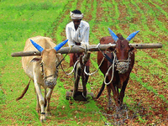





1. Introduction
14. Statistical Appendix

Slide 13

1. Introduction
14. Statistical Appendix

Slide 15
Chapter 1 State of the Economy

Slide 16
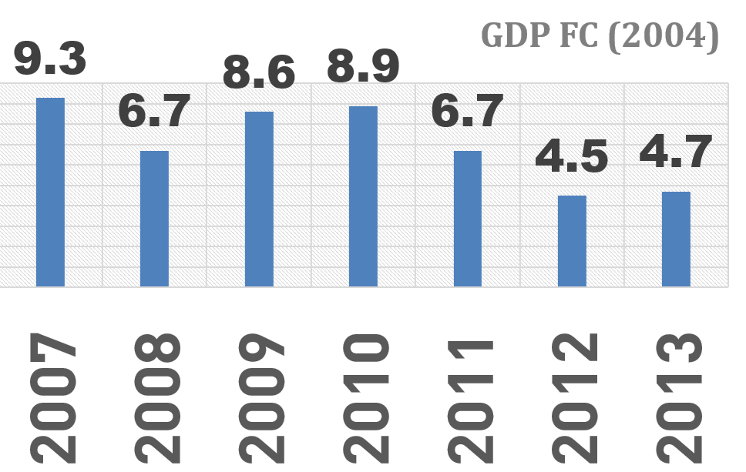
>9%: 2005, 2006, 2007
<5%: 86, 87, 2012, 2013

Slide 17
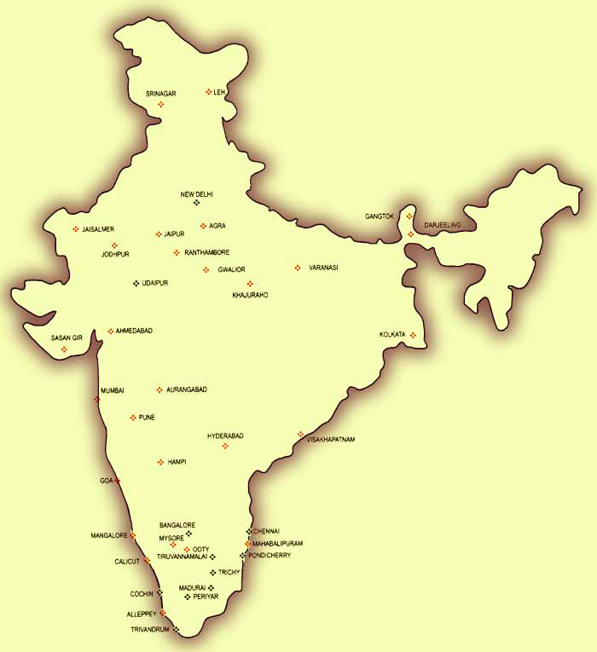



Gross
Domestic
Product
++
++
NA

Slide 18

Nominal GDP
2012, 100
2013, 150

Slide 19
Nominal GDP
2004, **
GDP
deflator
CSO Data
= Real GDP
2012, 150

Slide 20
Gross National Product
++
MINUS
GNP = GDP + Net Income from abroad
++

Slide 21

GNP
NNP (MP)
- Indirect TAXES
+ Subsidies
NNP (FC)

Slide 22
What is Net National Income? (1997)
NNP at market price
NNP at factor cost
Net Domestic Product at market price
Net Domestic Product at factor cost
1. Skip 2. Attempt 3. Mark n Review

Slide 23
GNP
NNP (MP)
- Indirect TAXES
+ Subsidies
NNP (FC) = National INCOME
Per capita National Income (2013): 74,380

Slide 24
What is Net National Income? (1997)
NNP at market price
NNP at factor cost (right)
Net Domestic Product at market price
Net Domestic Product at factor cost
1. Skip 2. Attempt 3. Mark n Review

Slide 25
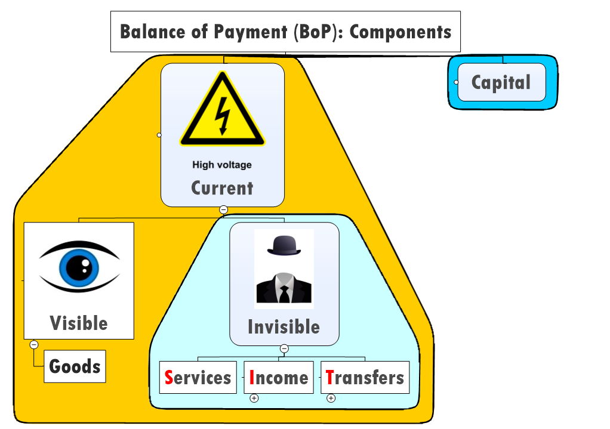
GNP
NNP (MP)
+ Current Transfer
National
Disposable
income

Slide 26
Background theory / formulas
NCERT Macro chapter 2
Topic 2.3 till end
Economic Survey ch1, Table 0.1 - GDP, production, inflation, deficit
Population: 121 crore (CENSUS 2011)

Slide 27
>9%: 2005, 2006, 2007
<5%: 86, 87, 2012, 2013

Slide 28
GDP Decline why?
Global slowdown
Inflation: financial assets << Physical
Infra/ supplyside bottlenecks
coal linkages, environment clearance
Mfg: low value addition to raw material
Unskilled labor
Agro => APMC, high food inflation

Slide 29
CH1. GDP Decline why?
Decline higher than emerging economies
PSU dividend, NOT expansion
Ref Box 1.1
Structural constrains
Investment rate 30% GDP => Sub-5% GDP
Investment decline (not high) => GDP decline (High)

Slide 30
GDP Future?
7-8% GDP growth only after 2015 end
European Commercial Bank (ECB)
Negative deposit interest (minus 0.10%)
Spending => Import
IMF World GDP
2013: 3%,
2014: 3.6%

Slide 31
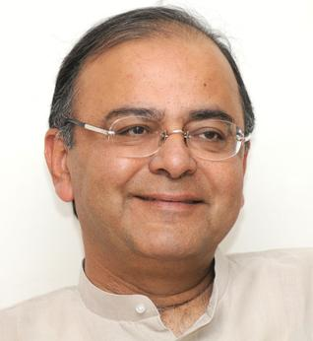
Jaitley budget aim
7-8% Growth in next 3-4 years
Aim: lesser TWIN DEFICIT
Lesser fiscal deficit
Lesser CAD

Slide 32
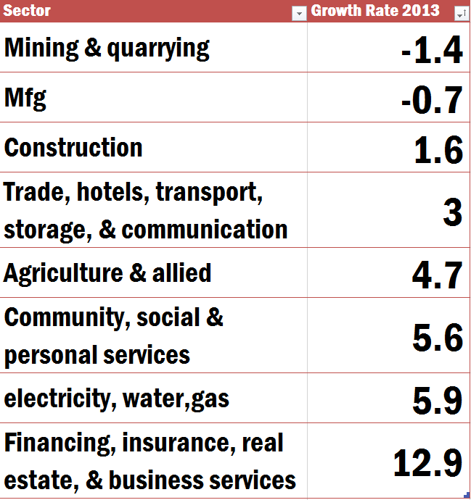
Sectoral growth trends (Point: 1.6)
Notes:
Then just reading table

Slide 33
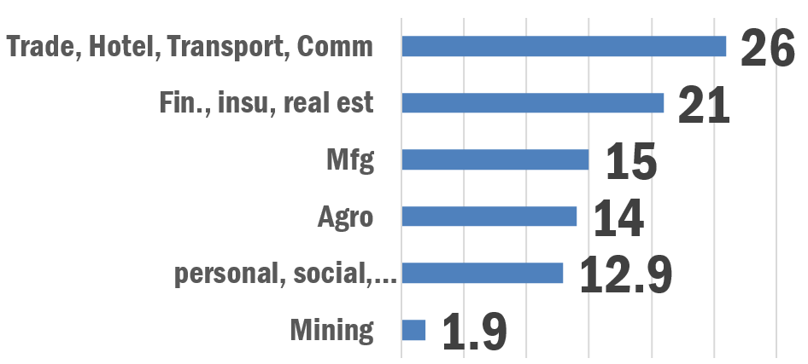
Sector share in GDP (Table 1.2)

Slide 34
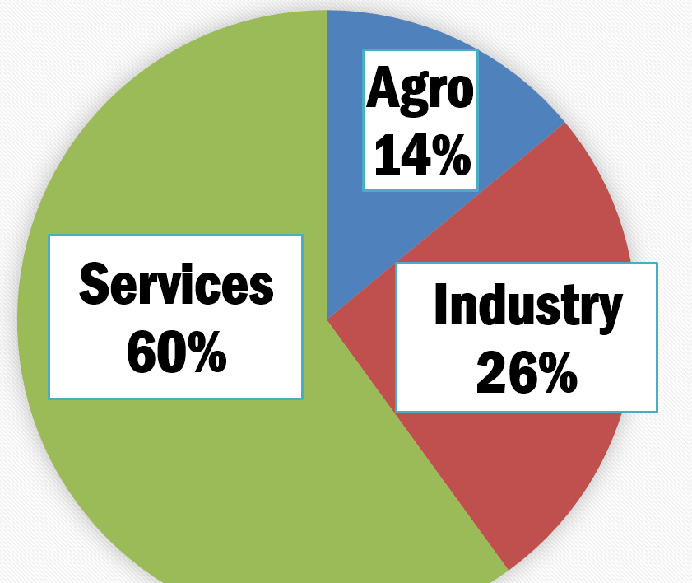
Sectoral share in GDP (Table 1.2)
Notes:
jobs

Slide 35
2007
Which one of the following is the correct sequence in the decreasing order of contribution of different sectors to GDP?
Services-Agriculture-Industry
Industry-Services-Agriculture
Industry-Agriculture-Services
Services-Industry-Agriculture
1. Skip 2. Attempt 3. Mark n Review

Slide 36
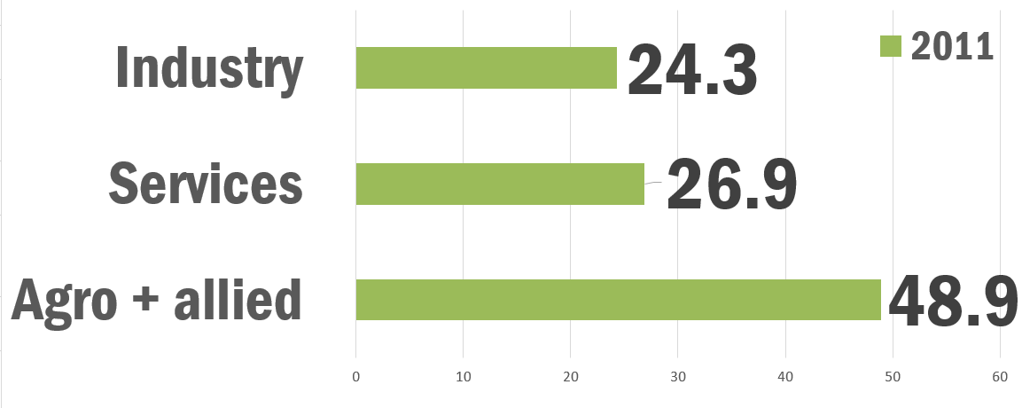
Share of sectors in Employment Box 1.2

Slide 37
Formula: Aggregate Demand (1.16)
Final consumption
+ investment (I)
+ Net export (-import)

Slide 38
Aggregate Demand
Aka effective demand
Demand for GDP of a country
Growth rate (AD) decreased

Slide 39
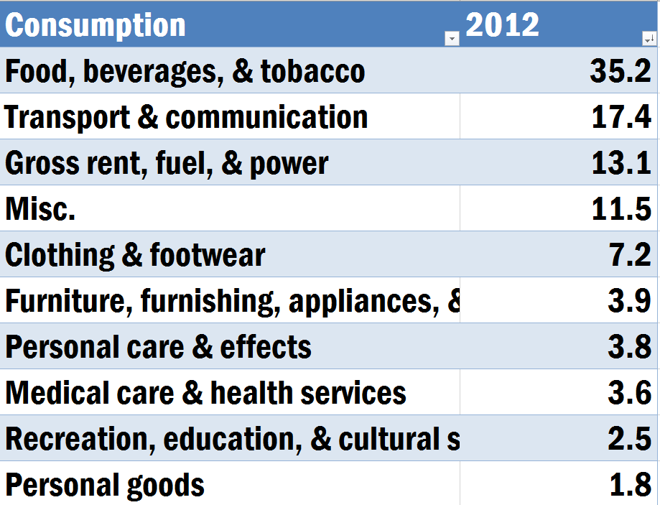

Slide 40
Public sector 1%
Highest
2007
36%
Private sector 7%
Household
Physical 15%+ Financial 7%
Total savings rate (~30 GDP%)
2012

Slide 41
Assertion reasoning
(A) Savings rate declined significantly in recent years, for Indian Economy
(R) Households tended to save more in physical than financial assets in recent years.
Correct ans: both right, R DOESNOT explain A.
Ref. Ch1, Page14

Slide 42
Public sector 1%
Highest
2007
36%
Private sector 7%
Household
Physical 15%+ Financial 7%
Total savings rate (~30 GDP%)
2012

Slide 43
Assertion reasoning
(A) Savings rate declined significantly in recent years, for Indian Economy
(R) Households tended to save more in physical than financial assets in recent years.
Correct ans: both right, R DOESNOT explain A.
Ref. Ch1, Page14

Slide 44
Assertion reasoning
(A) In recent years, overall investment rate has declined for Indian economy
(R) private corporate investment rate has declined in recent years.
Correct answer: both right, R explains A.
Ref. Ch1, Page10 sidebox

Slide 45
Ch.1: page 12 onwards
Gold import, CAD (BoP chapter)
Fiscal deficit, FRBM (public finance chapter)
Inflation (ch. Price Management)
BoP, Fed Tapering (lecture)
overview of other Chapter

Slide 46
Chapter 2
Public finance => Today’s lecture
inflation => Agriculture + Urjit (FI)
Capital markets => FI

Slide 47
Types of Reforms
Short term | Stroke of a pen reforms. e.g. POSCO plant.
Medium term | Via budget
Long term | Via legal-regulatory-Administrative reforms.

Slide 48
Can long term reforms affect Short term?
Higher dividend expect: stock market boom
Households: less savings, more borrowing
FDI, FII attract

Slide 49
Factor Market Reform
Land market
Labour market
Acquisition
land title
computerization of records
Hire fire
trade union

Slide 50
Factor Market Reform: Capital Market
FSLRC
Indian Financial code
Regulatory sector reform
Mumbai: international financial centre like London, NY Singapore

Slide 51
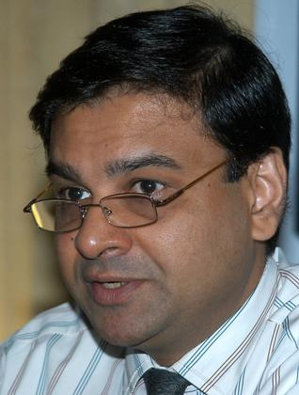
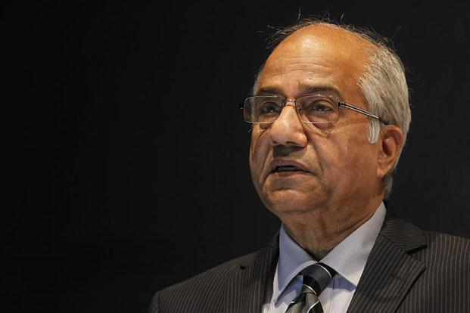
Chapter 2
Public finance => Today’s lecture
inflation => Agriculture + Urjit (FI)
Capital markets => FSLRC (FI)

